Slide 1

Time series Thailand Temperature prediction due to Climate Change
Deep Learning Assignment 3

Slide 2
Highlights
This project compares three different RNN models (SimpleRNN, LSTM, GRU) with a non-Dl technique model (AutoRegressive) for forecasting the tough temperatures in Thailand
This study used a kaggle dataset to analyze how average temperatures in Thailand changed rapidly during Jan 1863 - Aug 2013.
In terms of MAE comparison, you will see what the performance would be for various results of RNN with a non-Dl technique model (Auto-Regressive).
In this investigation, the interesting finding was that GRU model was the most potent model.
LSTM and GRU train much faster than SimpleRNN

Slide 3
Agenda
01
Introduction
04
Autoregressive model
02
Data Retrieval and Preparation
Results
05
03
Network architecture and Training of DL method
06
Discussion and Conclusion

Slide 4

Introduction
Some argue that global warming is the greatest peril our generation, while others argue that it is a fiction based on dubious science. In this study, we provide some data so that you can make your own assumptions.
There's a lot of data cleaning and preparation that goes into putting together a long-term study of weather patterns, even more than with other data sets that Kaggle has covered. Technicians used mercury thermometers to collect early data, and any fluctuation in visit duration had an impact on measurements.

Slide 5
Introduction
Many weather stations were relocated in the 1940s due to airport building. Electronic thermometers, which are thought to have a cooling bias, were particularly popular.
Given this intricacy, a multitude of different organizations gather information on climate trends. NOAA's MLOST, NASA's GISTEMP, and the UK's HadCrut are the three most widely used atmospheric and oceanic temperature data sets.
We repackaged the data from a more recent Berkeley Earth compilation, which is linked with Lawrence Berkeley National Laboratory. The Berkeley Earth Surface Temperature Study brings together 1.6 billion temperature reports from 16 repositories.

Slide 6
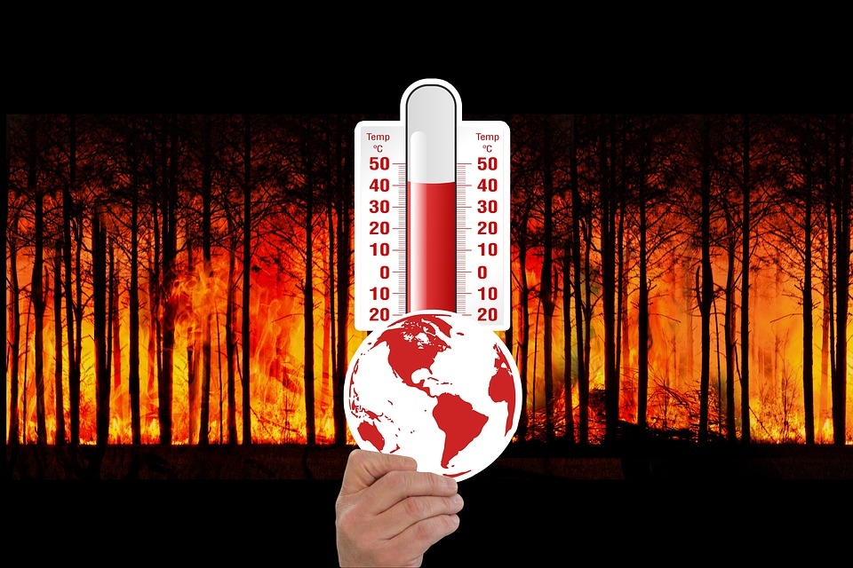
Introduction
It comes in a neat bundle and can be sliced into interesting subgroups (for example by country). They make the underlying data as well as the code for the alterations they performed public. They also employ approaches that allow for the inclusion of weather records from shorter time series, resulting in fewer observations being discarded.
The average land temperature in this dataset from Kaggle begins in 1750, while the maximum and minimum land temperatures, as well as worldwide ocean and land temperatures, commence in 1850.
Since we live in Thailand, we chose Thailand to focus on the small scale for this scope of study.

Slide 7
Purpose
To test the accuracy of average Thailand's temperature forecasts using four alternative models. *
To compare the efficacy of four different model forecasts for average Thailand’s temperatures.
The aims of this study are:
* The four models in this study are:
1) RNN 2) LSTM 3) GRU 4) AutoRegressive

Slide 8
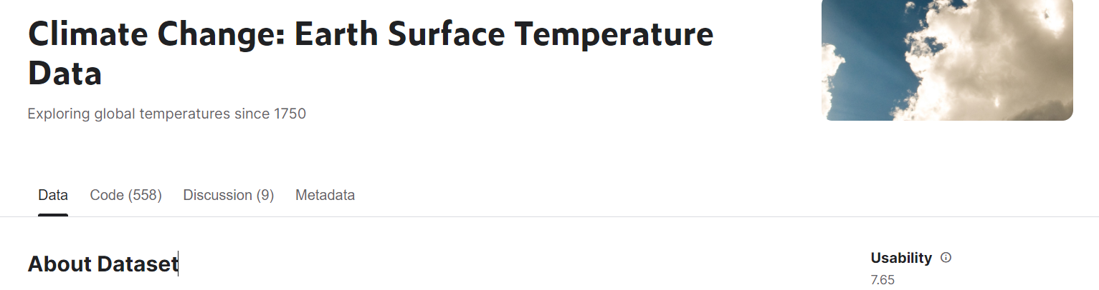
Data Retrieval
The dataset was mainly retrieved from kaggle dataset- Climate Change: Earth Surface Temperature Data,the open dataset and free for use.
URL: https://www.kaggle.com/datasets/berkeleyearth/climate-change-earth-surface-temperature-data
“GlobalLandTemperaturesByCountry” was a csv file to employ in this study.
There were 1808 rows × 4 columns during Jan 1863 - Aug 2013.

Slide 9
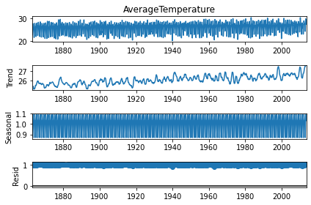
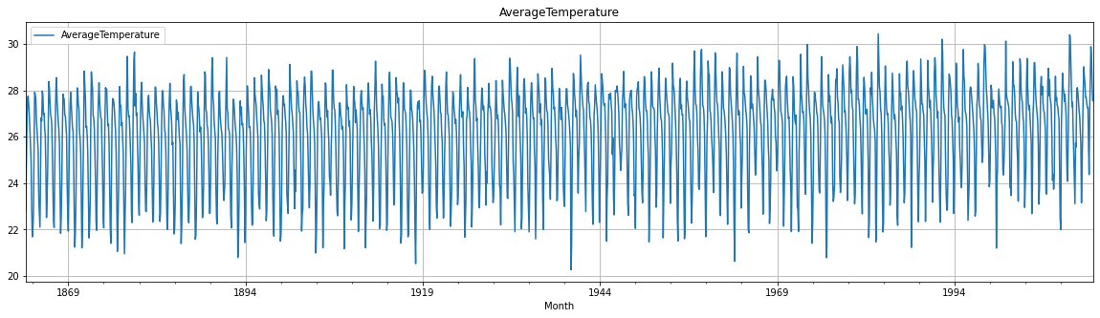
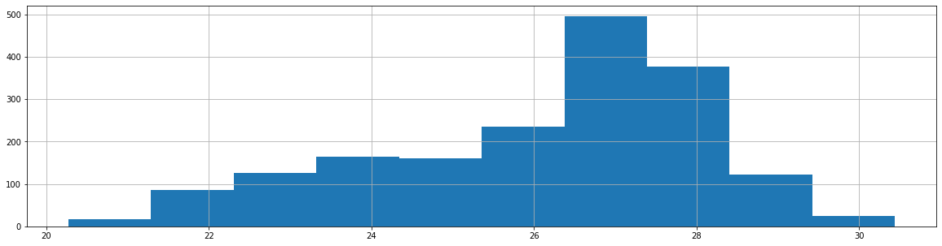
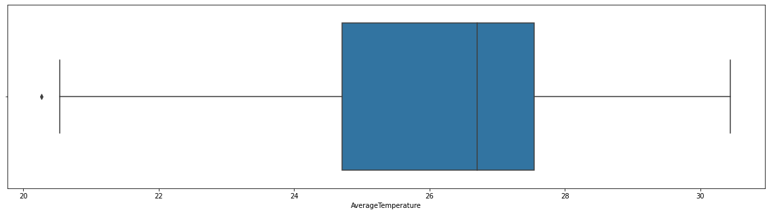
Data Exploration
Plot time series data
Multiplicative seasonal decomposition
Histogram plot
Box plot and interquartile range

Slide 10
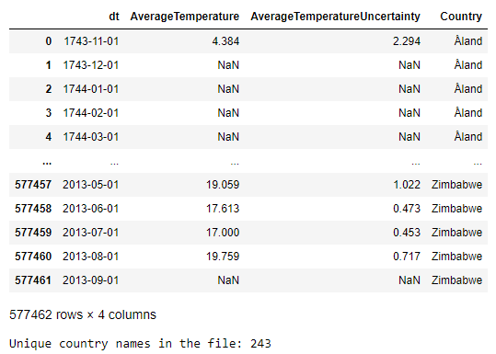
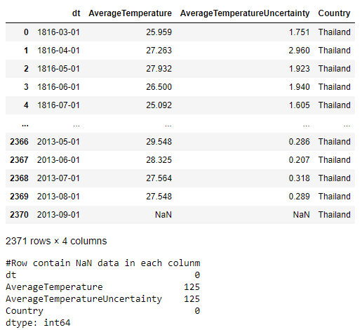
Data Preparation
Original data
Thailand data
The original file contains temperature data for 243 unique countries
Since our project focuses only on Thailand, the other countries data were filtered out using pandas
However Thailand data still contains 125 rows of NaN data

Slide 11
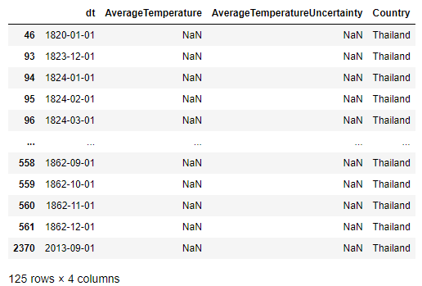
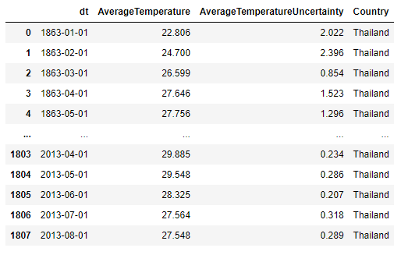
Data Preparation
Thailand NaN data
Thailand data after cleaning
After exploring the NaN data, we found that the data after index 561 (dt=1862-12-01) did not contain any NaN data except the last row data
So the data used will be the data from index 562 to 2369 (the row before the last row)

Slide 12
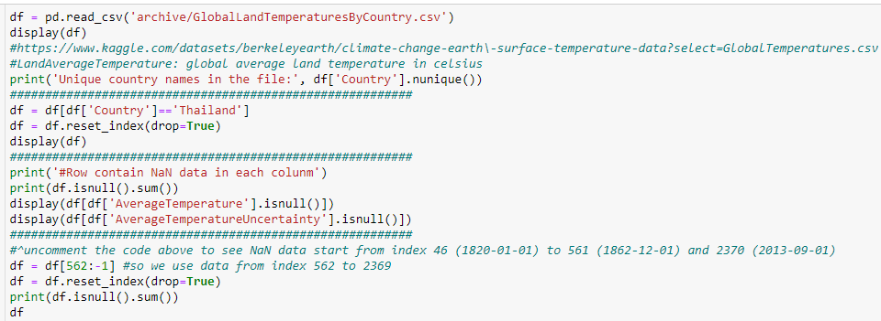
Data Preparation Code

Slide 13
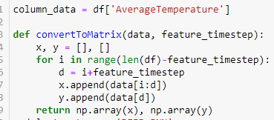
Data Preparation
CODE: Transform raw data to training data set form
Raw data will be transformed to deep learning desired form by calling convertToMatrix function
Transformed shape depends on the number of feature timestep parameter called during each experiment

Slide 14
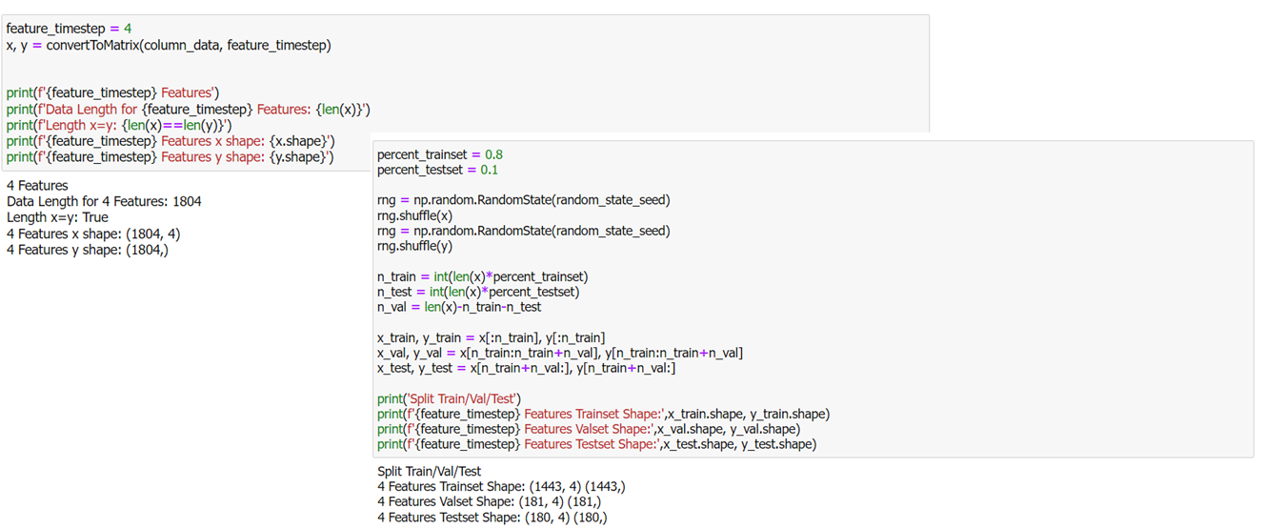
Data Preparation

Slide 15
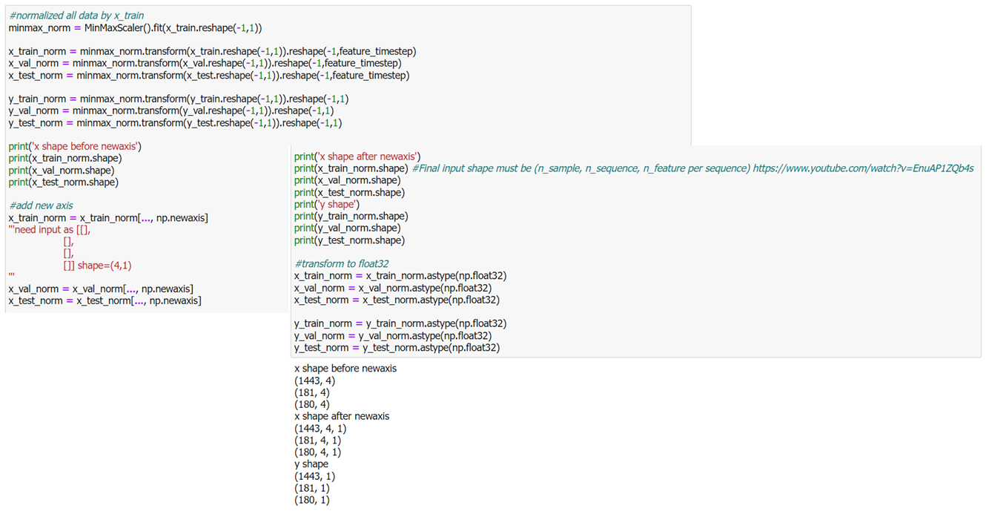
Data Preparation : Normalized all data by x_train

Slide 16
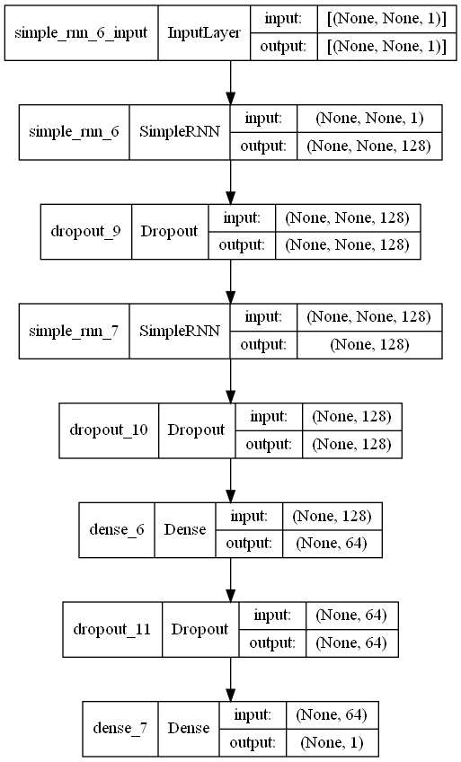
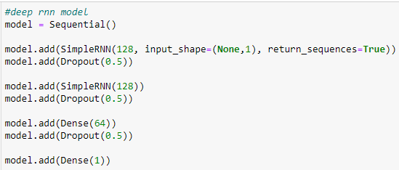
Network Architecture: Deep RNN
Deep RNN model consists of
SimpleRNN layer (128 neurons, activation=tanh)
Dropout layer (0.5 dropout rate)
SimpleRNN layer (128 neurons, activation=tanh)
Dropout layer (0.5 dropout rate)
Dense layer (64 neurons)
Dropout layer (0.5 dropout rate)
Dense layer (1 neuron)
Deep RNN model structure
CODE: Deep RNN model

Slide 17
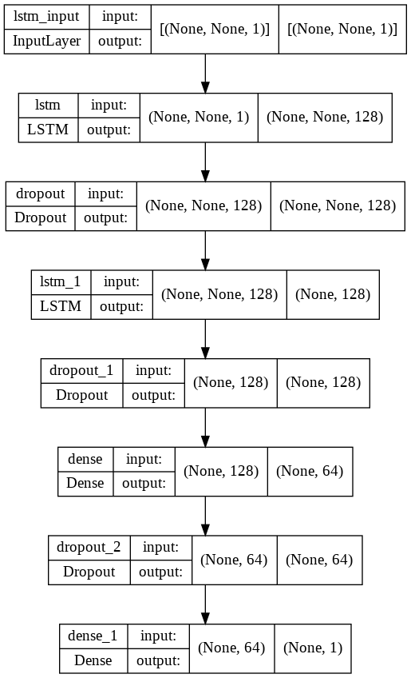
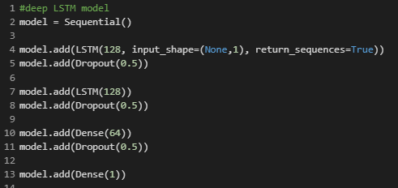
Network Architecture: LSTM
Deep RNN model consists of
LSTM layer (128 neurons, activation=tanh)
Dropout layer (0.5 dropout rate)
LSTM layer (128 neurons, activation=tanh)
Dropout layer (0.5 dropout rate)
Dense layer (64 neurons)
Dropout layer (0.5 dropout rate)
Dense layer (1 neuron)
LSTM model structure
CODE: LSTM model

Slide 18
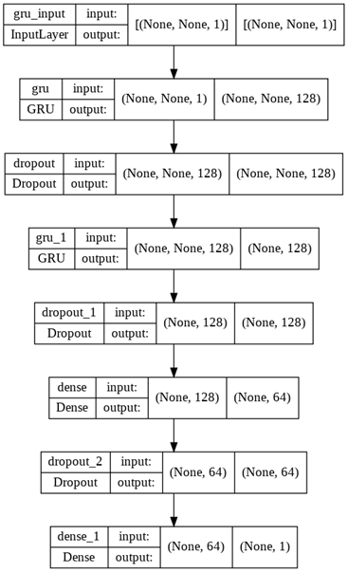
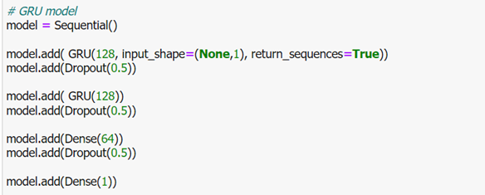
Network Architecture: GRU
Deep RNN model consists of
GRU layer (128 neurons, activation=tanh)
Dropout layer (0.5 dropout rate)
GRU layer (128 neurons, activation=tanh)
Dropout layer (0.5 dropout rate)
Dense layer (64 neurons)
Dropout layer (0.5 dropout rate)
Dense layer (1 neuron)
GRU model structure
CODE: GRU model

Slide 19
Training
All deep learning models (Deep RNN, LSTM and GRU) the training/validation//testing dataset are as follows:
training set:
x_train_norm, y_train_norm
validation set:
x_val_norm, y_val_norm
testing set:
x_test_norm

Slide 20
Training
All deep learning models (Deep RNN, LSTM and GRU) the training parameters was set as follows:
training parameters:
optimizer = adam(learning rate=0.001, decay=1e-6)
loss = mean absolute error
(MAE was selected instead of RMSE because the error calculated from predicted output is a normalized output which is a decimal number, using RMSE will lower down an actual error, so MAE was selected to truly represent an actual error)
performance metric = mean absolute error
The best trained model was saved using ModelCheckpoint monitored on minimizing validation loss
epochs = 100
batch size = 10

Slide 21
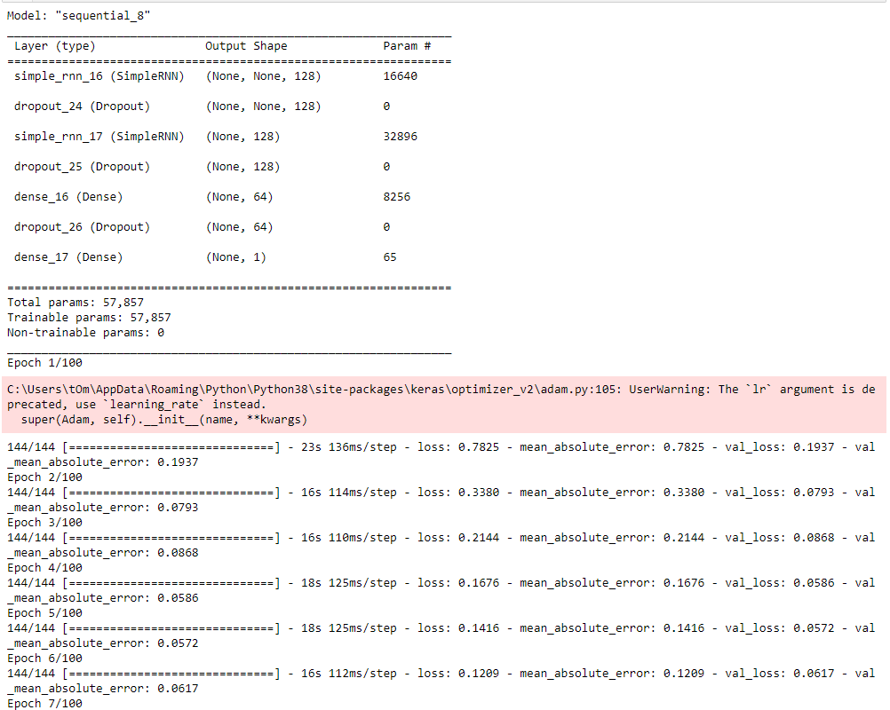
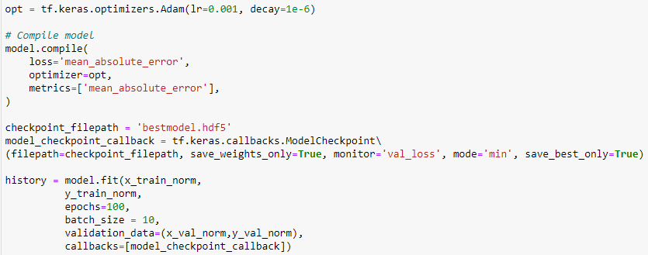
Training
CODE: Training
Training output

Slide 22
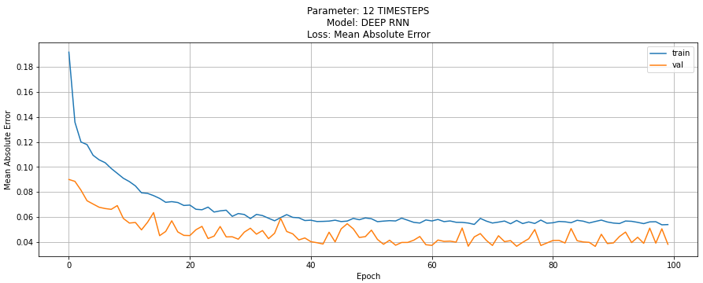
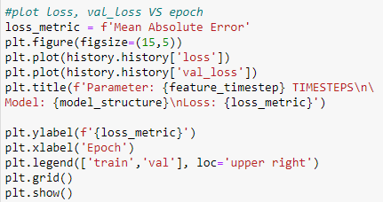
Training
For each model, the plot of MAE in training and validation set on each training epoch is plotted see how the training goes and to detect if there was any abnormal error during the training
CODE: MAE plotting
Training set and validation set MAE on each training epoch
(Example from Deep RNN with 12 timesteps feature)

Slide 23
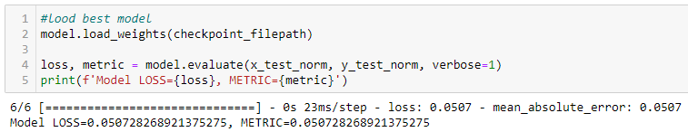
Training
Then the best model from training session was loaded
The best model was tested on validation set to see how the model perform
(the loss/metric from this session still represents in normalized value)
The actual prediction for test set was performed by the best model and then inverse transform(denormalized) to present an actual predicted temperature
The results will be further interpreted and concluded in result section
CODE: Loading best model and validating on validation set
(Example from Deep RNN with 12 timesteps feature)
CODE: Test set temperature prediction and denormalization

Slide 24
Training
The deep learning model training time comparison (from command %%time) with machine specifications as followed are shown in the table below
Machine Specifications:
CPU: Intel(R) Core(TM) i5-8300H CPU @ 2.30GHz 2.30 GHz
RAM: 24.0 GB (23.9 GB usable)
GPU: NVIDIA GeForce GTX 1050Ti
Model | Timesteps Feature
 | 4 | 6 | 12
Deep RNN | 11m 28s | 16m 6s | 27m 54s
LSTM | 3m 59s | 3m 55s | 4m 19s
GRU | 3m 54s | 3m 38s | 3m 35s

Slide 25
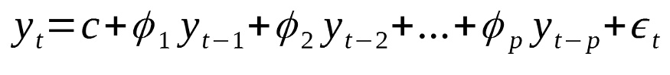
Auto Regressive model
In order to deal with the forecasting task of time-series dataset, auto regressive model is usually chosen to be the one to predict the outcome of the future values based on previous data values.
An autoregressive model uses a linear combination of past values of the target to make forecasts and is made against the target itself. Where lags express each data point across time is called a lag, Bias and weight are associated with each lag which tells the importance of that time step in predicting the final value and Autocorrelation is the relationship between forecasted variable and input variables.

Slide 26
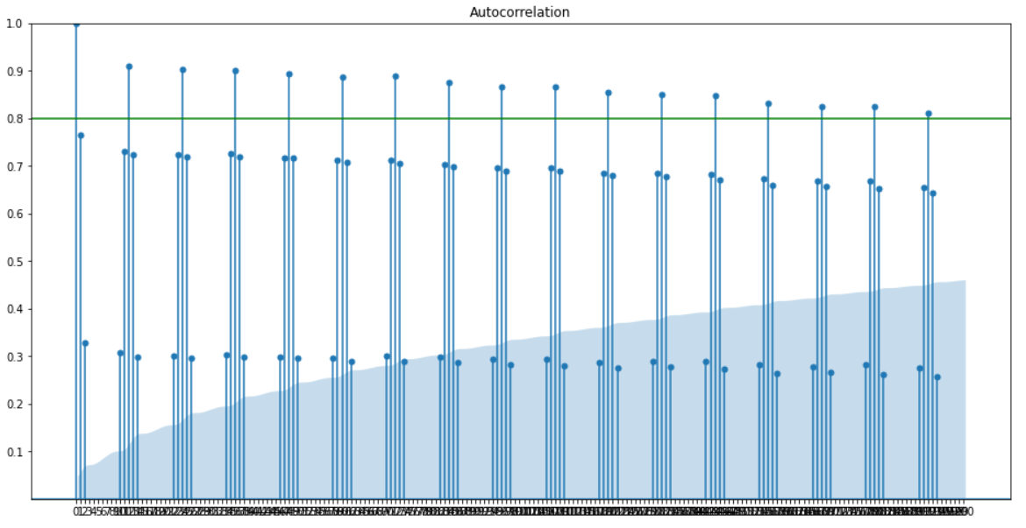
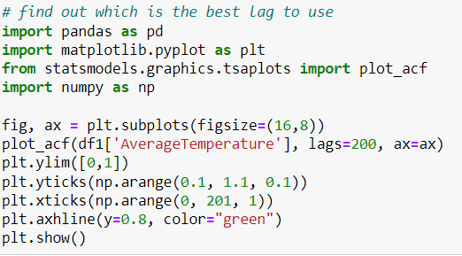
Finding autocorrelation
In order to find out which lags have a strong correlation to the forecasted values, The code creates a plot that shows us how much each previous lag influences the future lag.
Then we provide a threshold of 0.8 to see the lag that has a very strong correlation to the future value. The lag that we are looking for is 192 which goes above the threshold.
CODE: Finding which lag is the best lag to use
Autocorrelation and lag plot

Slide 27
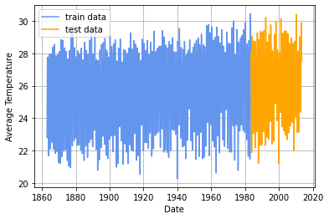
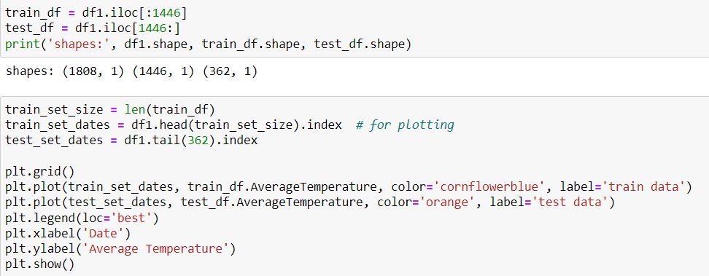
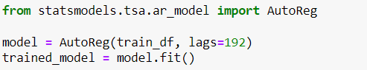
Training Auto Regressive model
CODE: Splitting training set and testing set
Date and time that used for training and testing
CODE: Creating and fitting the model

Slide 28
Results

Slide 29
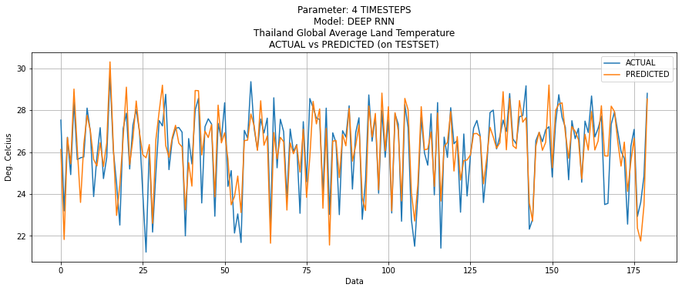
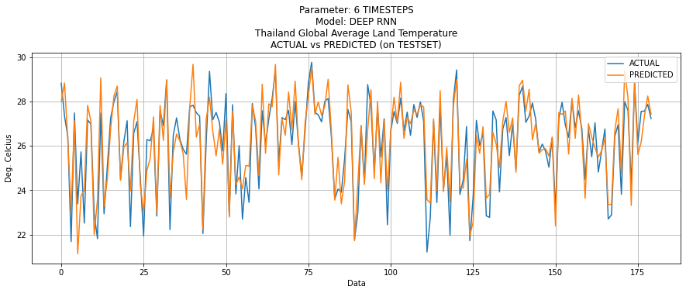
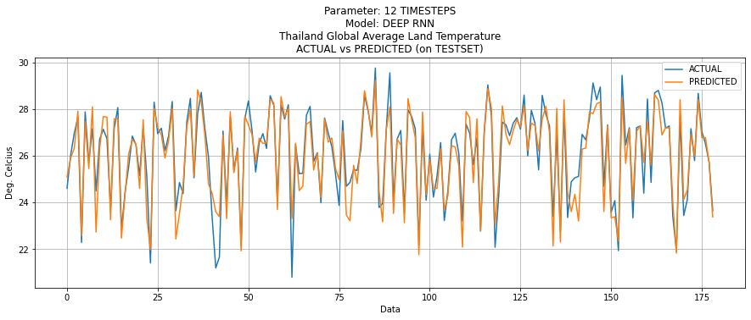
VISUALIZED RNN RESULTS FOR EACH TIMESTEP

Slide 30
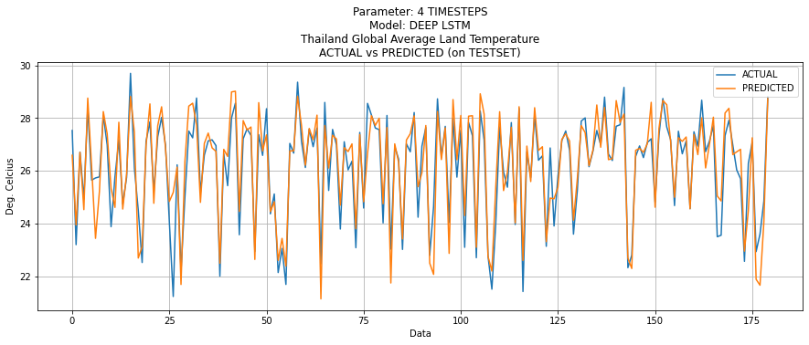
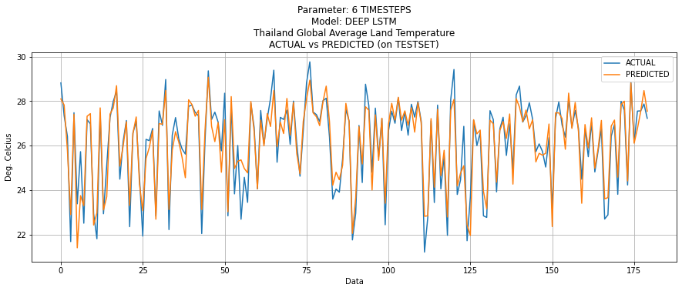
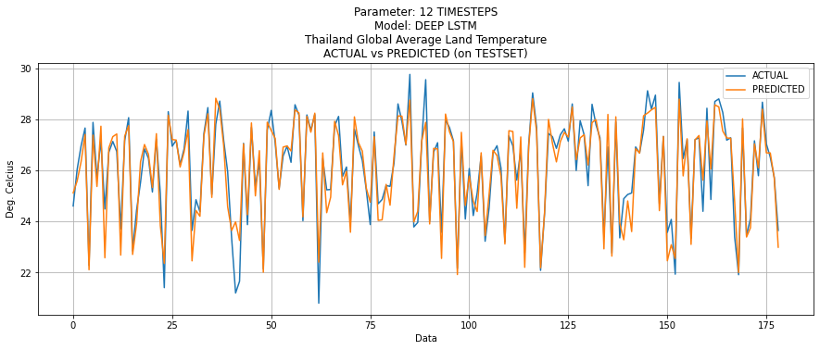
VISUALIZED LSTM RESULTS FOR EACH TIMESTEP

Slide 31
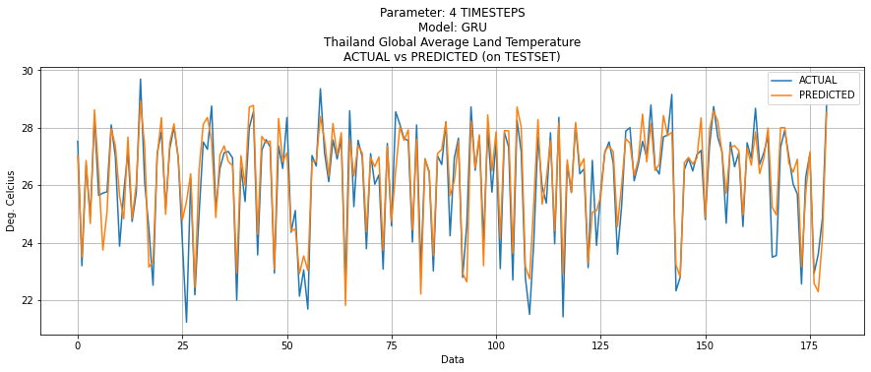
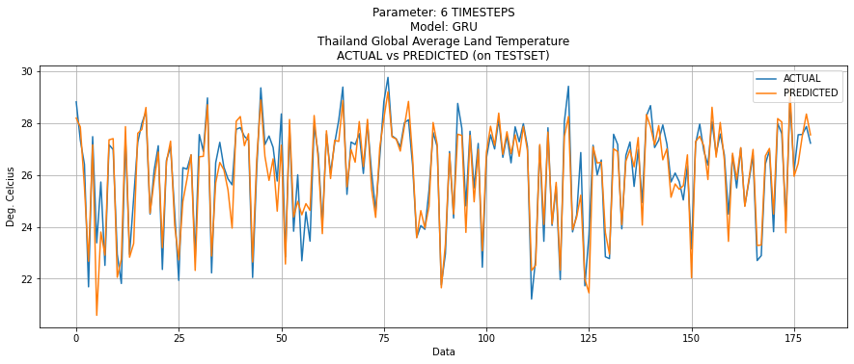
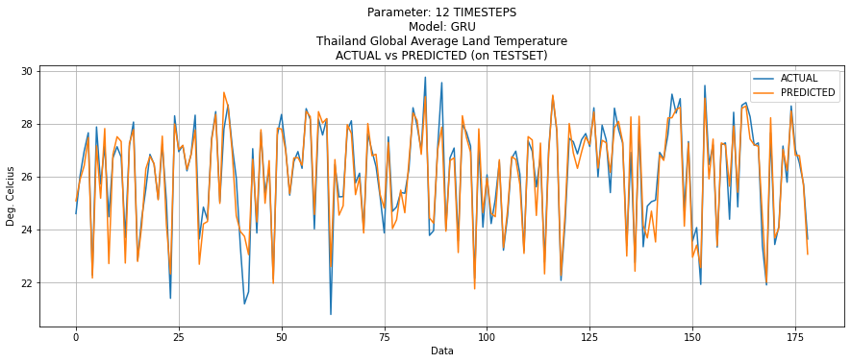
VISUALIZED GRU RESULTS FOR EACH TIMESTEP

Slide 32
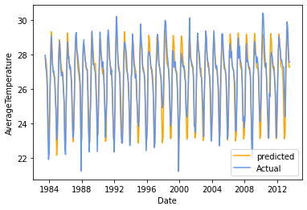
VISUALIZED AUTOREGRESSIVE RESULTS

Slide 33
MAE Evaluation on Test Set
Models | 4 Times | 6 Times | 12 Times
RNN | 0.785 | 0.650 | 0.516
LTSM | 0.576 | 0.493 | 0.433
GRU | 0.551 | 0.482 | 0.411
AutoRegressive | 0.531

Slide 34
Conclusion
According to the experiment, the all deep learning’s best models (Multi-layer RNN, LSTM and GRU) have better performance compared to the autoregressive method. Comparing among the deep learning model, the GRU model has minimum MAE at 0.411. The second best is LSTM at 0.433 and the last on is RNN at 0.516. We’ll find that the GRU and LSTM model outperform the RNN model.
In term of input time step which is one of the important hyper-parameters, we found that the 12 time-steps input made the model the best outcome comparing to 4 and 6 time-steps input. There is a point to mentioned that the data were collected on the monthly basis and the temperature data is affected from the season of the year which may be the reason that 12 time-steps input show the best result in these experiments.

Slide 35
Discussion
The results are quite good with MAE around 0.4 - 0.8 which is acceptable for temperature prediction. However, in some cases which require more accurate prediction, the configuration of GRU and LSTM model should be considered to achieve more accurate model.
For other cases which the data may not be collected on the monthly basis, the best input time step may not be 12 as per these experiments. The input time step should be taken into account and properly fine-tuned based on each data.

Slide 36
References
Python Version: 3.8.5
Python Library
Matplotlib 3.5.1
Numpy 1.22.0
OpenCV 4.5.5
Pandas 1.3.0
Tensorflow 2.7.0
Source Code
Data preparation and model training code referenced from RNN_ex1.py (BADS7604 by Asst. Prof. Thitirat Sribiborbornratanakul)
Datasets
From Climate Change: Earth Surface Temperature Data (https://www.kaggle.com/datasets/berkeleyearth/climate-change-earth-surface-temperature-data?select=GlobalTemperatures.csv) with license: Attribution-NonCommercial-ShareAlike 4.0 International (CC BY-NC-SA 4.0)

Slide 37
Citing
For those who want to use any presentation images please reference the image in bibtex format

Slide 38
Team Members
(25%) Highlights, Data preparation, Network Architecture, Experimental variation on LSTM, Conclusion and Discussion
6310412018
Pongsarat
Chootai
(25%) Data exploration, Autoregressive model, and Report (Collecting and comparing the results)
6310412021
Theethut
Narksenee
(25%)
Programming: Develop Data Preparation and Deep Learning Base Code
Presentation: Data Preparation, Model Architecture(Deep RNN), Training(Deep Learning) and Miscellaneous(References, Citing, End Credit)
6310412024
Saranchai Angkawinijwong
(25%)
Introduction and Highlights composition, Data preparation, Network Architecture, Experimental variation on GRU mode
6420400001
Krittipat
Chuenphitthayavut

Slide 39
End Credit
This project is a part of Deep Learning course
Course code: BADS7604
Syllabus: Business Analytics and Data Science (BADS)
Institute: National Institute of Development Administration (NIDA)
Semester: 2/2021

Slide 40
Thank you for your attention

